Slide 1
Advance Database Management System Hadoop and its Ecosystem Meghashree Maddihally Nagoji

Slide 2
Hadoop Distributed File System (HDFS)
Following are the components of HDFS Architecture:
NameNodes
DataNodes
HDFS Client
CheckPointNode
BackupNode
Data Replication

Slide 3
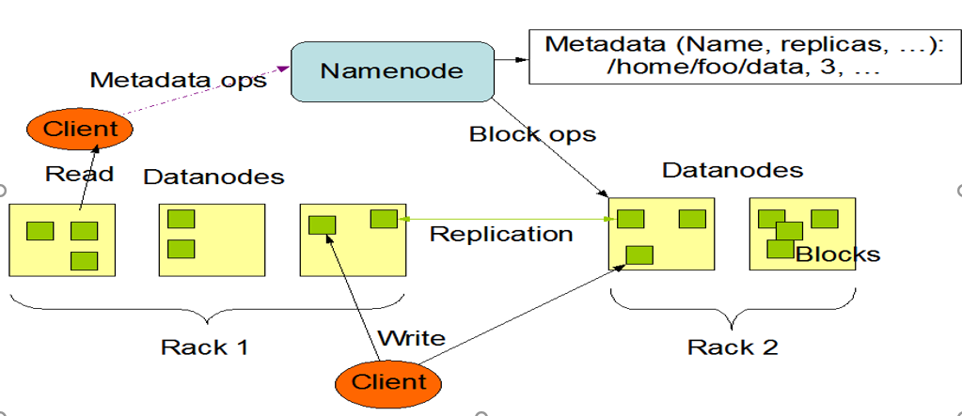
HDFS Architecture
HDFS follows a Master-Slave Architecture:

Slide 4
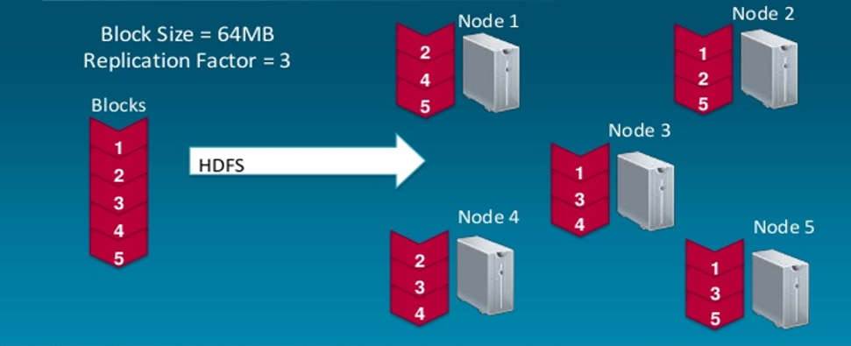
Data Replication
Hadoop replicates each block across several machines:

Slide 5


HIVE
Following are the major components of HIVE Architecture:
Metastore
Driver
Compiler
Executor
Interface

Slide 6
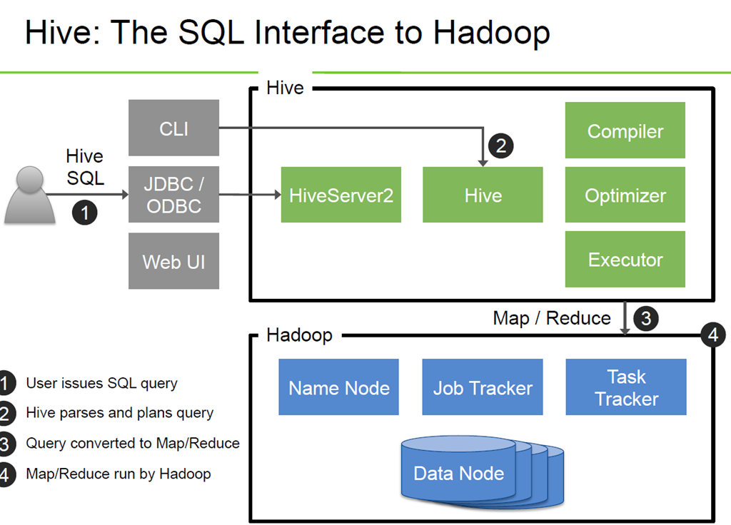
How HIVE Works
Hive interaction with Hadoop is as follows:

Slide 7
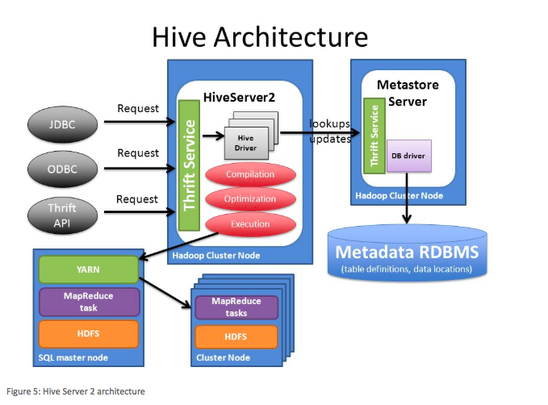
HIVE Architecture
Architectural Framework of HIVE

Slide 8
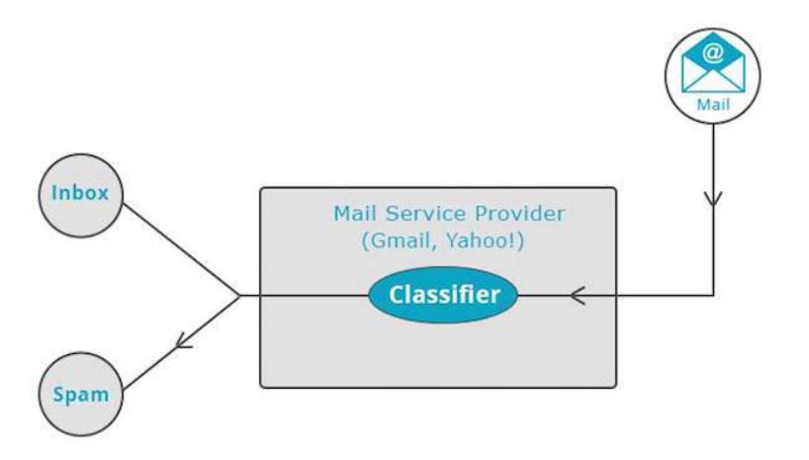
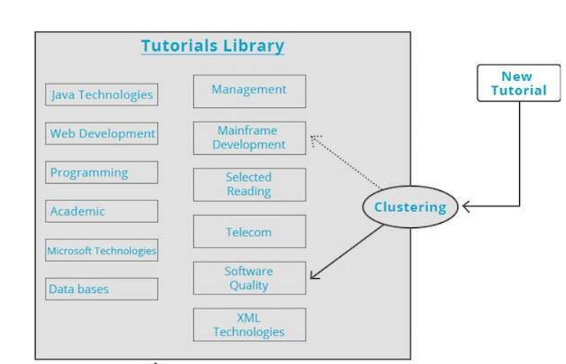
MAHOUT
Popular machine learning techniques implemented by Mahout
Classification
Clustering

Slide 9
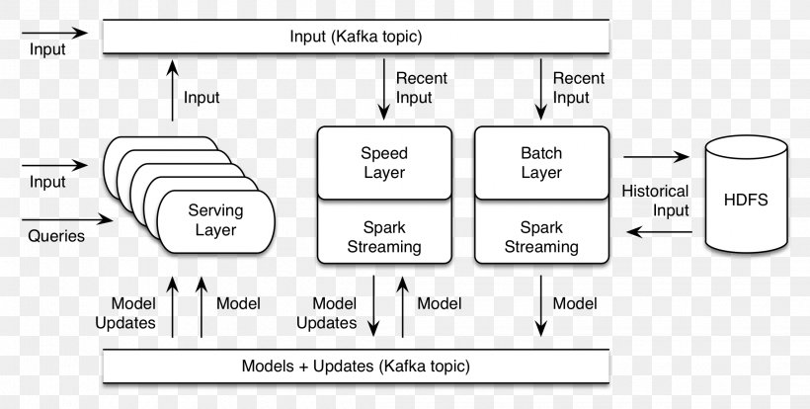
MAHOUT Architecture
Internal architecture of mahout

Slide 10
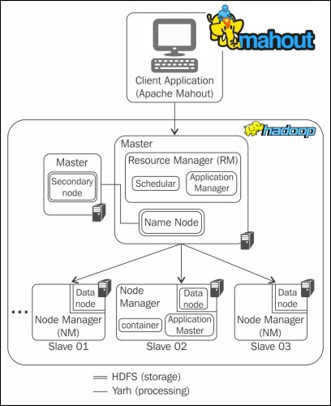
Working Of MAHOUT

Slide 11
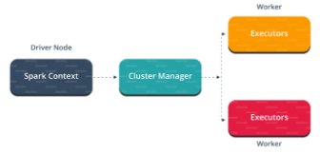
SPARK
Following are the components of SPARK Architecture:
Master
Spark Context
Cluster Manager
Worker Mode

Slide 12
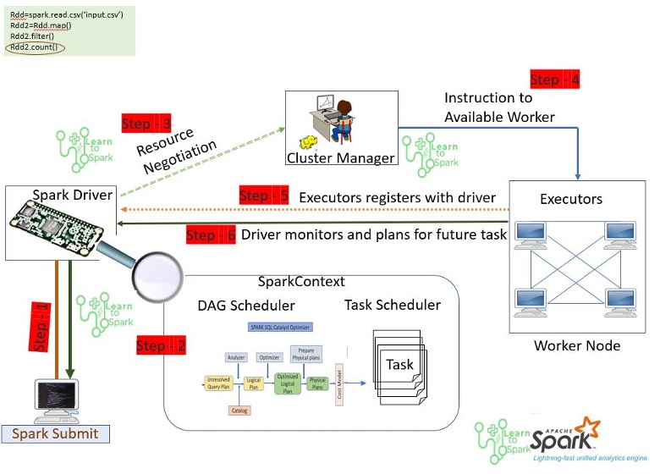
SPARK Process Operation

Slide 13
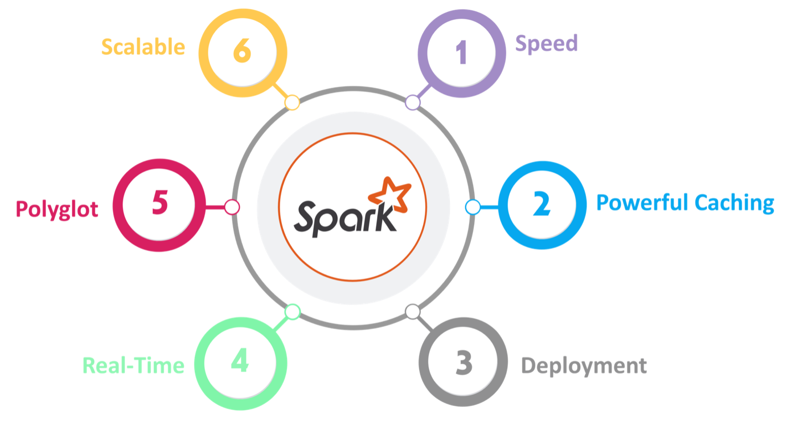
Features of Spark
Following are the major features of SPARK:
Speed
Powerful Caching
Deployment
Real Time
Polyglot
Scalable

Slide 14
Zookeeper Components
Client
Client
Client
Write
Read
Zookeeper Service Follower
Zookeeper Service Leader
Zookeeper Service Follower
Replicated Database
Request Processor
Replicated Database
Replicated Database
Atomic Broadcast
Atomic Broadcast
Atomic Broadcast
Writes are forwarded to the leader
Write

Slide 15
Zookeeper: Coordination kernel
A small set of operations which enable users to build their own coordination primitives or other constructs
Properties:
Wait-free operations instead of blocking
Operations operate over a hierarchy of data objects
Linearizable writes: Writes are ordered.
FIFO ordering of operations at client level: Operations from a client are executed in the order provided by the client
High performance, High availability
Allows asynchronous/synchronous operation at client side

Slide 16
Zookeeper Guarantees
Linearizable writes
FIFO Client Order
Ordering guarantees for watch notifications
Liveness
Durability

